Slide 1
Transform
Patrick Mathias
R/Medicine 2022

Slide 2
The Data Analysis Pipeline
Notes:
This is the generalized data science pipeline that was introduced to you earlier today. The functions we'll be learning about fit specifically in the "tidy" and "transform" portions of this workflow.

Slide 3
Notes:
In this session we'll be using functions that are part of the dplyr package. The dplyr package is part of the tidyverse meta-package and a workhorse for data transformation.

Slide 4
a grammar for transforming data frames
Notes:
Now dplyr isn't just a haphazard collection of functions. It takes a holistic almost philosophical approach to the transformation of data and implements it in an organized lexicon or grammar for programmatically transforming data.
What I mean when I say a grammar for transforming data really relates to 2 characteristics of the dplyr approach.
#1 In a similar way to how verbs operate on nouns, dplyr functions operate on a data frames.
#2 Dplyr functions use a consistent syntax which minimizes cognitive load so once you understand the dplyr approach with one function its easier to learn new functions

Slide 5
Select existing columns
Notes:
The first function we'll talk about provides tools for narrowing down a dataframe to just the columns you need for an analysis

Slide 6
select()
Extract columns from a data frame
= Number of rows
↓ Number of Columns
Notes:
This is done with the select function
Here you see the graphical framework for how select works. You provide the raw data as the input in the form of a data frame.
It will extract the columns of your choosing and return these columns as a new data frame.
In the output, you will wind up with all the rows that you started with and the columns defined in the select function.

Slide 7
select()
Extract columns from a data frame
select(data,... )
select(covid_testing, mrn, last_name)
data frame to transform
dplyr function
data frame to transform
name(s) of columns to extract
Notes:
You can see here that select() takes the starting data frame as its first argument. In this case it’s the "covid_testing" data frame.
After that it takes any number of additional arguments that specify the columns that you want to pick.
In it’s simplest form, those additional arguments will just be the names of the columns that you want to select. Like in this case we are indicating that we want to keep the mrn and last_name columns.
In very wide datasets, writing out the names of the columns you want just doesn’t scale so dplyr does have additional convenience functions that can help you succinctly identify the columns you want. We won't go over these together but they can be found in the data transformation cheat sheet in the appendix to your coursebook.

Slide 8

select()
Extract columns from a data frame
select(covid_testing, mrn, last_name)
description | department
PROTHROMBIN TIME | INTERNAL MEDICINE CLINIC
BASIC METABOLIC PANEL | INTERNAL MEDICINE CLINIC
THYROID STIMULATING HORMONE | ENDOCRINOLOGY CLINIC
T4, FREE | ENDOCRINOLOGY CLINIC
covid_testing
mrn | first_name | last_name | gender
5000876 | sarella | stark | female
5006017 | alester | stark | male
5001412 | jhezane | westerling | female
5000533 | penny | targaryen | female
mrn | last_name
5000876 | stark
5006017 | stark
5001412 | westerling
5000533 | targaryen
…
…
Notes:
So for example, if you were to run the code you see here, the snippet of the covid_testing data frame on the left would be accepted as input and a subset of it, the mrn and the last_name would be returned as output

Slide 9
Pop Quiz
Which of these would successfully select the first_name column from the covid_testing data frame?
A) select(first_name, covid_testing)
B) select(covid_testing, first_name)
C) select(covid_testing, -first_name)
D) select(covid_testing, First_Name)

Slide 10
Filter rows by logical criteria

Slide 11
filter()
Extract rows that meet logical criteria
↓ Number of rows
= Number of Columns
Notes:
Here you see the graphical framework for how filter works. You provide the raw data as the input in the form of a data frame.
Filter will use logical criteria you provide in the function to identify the rows that are required
In the output, you will wind up with all the columns that you started with and just the rows defined in the filter function.

Slide 12
filter()
Extract rows that meet logical criteria
filter(data, ...)
logical test
(return each row where
the test is TRUE)
data frame to transform
 |  |  | FALSE
 |  |  | FALSE
 |  |  | TRUE
 |  |  | FALSE
 |  |  | TRUE
 |  |  | FALSE
Notes:
In filter the first argument again is a data frame from which we will be extracting rows.
Afterwards we can input one more logical tests. R then performs that logical test on each row of the dataset and returns all rows in which the logical test is TRUE. Rows for which the tests are TRUE are returned in the output as a data frame and the rest are removed.
The key point here is that the logical tests are evaluated row by row, one at a time, independently.

Slide 13
filter()
Extract rows that meet logical criteria
filter(data, column_name == criteria )
logical test
(return each row where
the test is TRUE)
 |  |  | FALSE
 |  |  | FALSE
 |  |  | TRUE
 |  |  | FALSE
 |  |  | TRUE
 |  |  | FALSE
Notes:
Let's zoom in for a second on those logical tests.
Generally speaking they will take this form.
There will be some column that contains the data you want to filter on, like the clinic name, or the patient MRN.
Then there will be a logical test, what you see here is equals, you can also have greater than, less than etc.
And then you have the criteria. Equal to what? Greater than what number?
OK let's see some real examples →

Slide 14
filter(covid_testing, mrn == 5000083)
mrn | first_name | last_name
5000876 | sarella | stark
5006017 | alester | stark
5001412 | jhezane | westerling
5000083 | lollys | clegane
mrn | first_name | last_name
5000083 | lollys | clegane
FALSE
5000876 | sarella | stark
FALSE
5006017 | alester | stark
FALSE
5001412 | jhezane | westerling
TRUE
Notes:
Here's an example. We supply the covid_testing data frame as the first argument. Afterwards we provide one logical test; we ask filter() to return rows in which the mrn is 5000083.
Filter will go row by row, starting from the very first row and ask is the value in the mrn column equal to 500083 for that row, as you can see it's not – so it gets an imaginary value of false. →
It then goes to the second row, again checks to see if the mrn is a match, it's not so it also get's a false.→
And so on for the third →
But in the fourth you can see we do have a match – so that gets a TRUE. →
So the output of this function is a data frame with the same number of columns but only the rows that resulted in a TRUE based on the criteria in the function

Slide 15
Values coded as character strings must be surrounded by quotes
filter(covid_testing, last_name == "stark")
mrn | first_name | last_name
5000876 | sarella | stark
5006017 | alester | stark
5001412 | jhezane | westerling
5000083 | lollys | clegane
mrn | first_name | last_name
5000876 | sarella | stark
5006017 | alester | stark
TRUE
TRUE
FALSE
FALSE
Notes:
Similarly we can ask filter to return just the rows that represent tests for a specific patient, like stark.
In this case the first two rows result in TRUE and so are kept
Note that when asking filter to return rows with specific text inside of it, we have to put that text in quotes and it's got to be an exact match, partial matches don't count.

Slide 16
filter()
Extract rows that meet logical criteria
filter(data,... )
logical test
(return each row where
the test is TRUE)
data frame to transform
data frame to transform
Notes:
So what we've seen is that the output of a filter() function is completely dependent on the logical operators in this green square. Rows in which the logical statement results in a TRUE are returned and those that are FALSE will not be returned. So the next question of course is how do you construct logical statements in R.

Slide 17
Logical tests
x < y | Less than
x > y | Greater than
x == y | Equal to
x <= y | Less than or equal to
x >= y | Greater than or equal to
x != y | Not equal to
Notes:
R provides logical operators for every occasion. Here are just some of the important logical operators to know about.
We’ve already seen the double equals. Theres also the less than or and greater than operators. These each also come as “or equal to” versions.
Use exclamation point-equals (!=) if you want to select rows in which a value is not equal to something else.

Slide 18
Pop Quiz
Which of these would successfully filter the covid_testing data frame to tests with positive results?
A) filter(covid_testing, result == positive)
B) filter(covid_testing, result = "positive")
C) filter(covid_testing, result == "positive")
D) filter(covid_testing, positive == "result")

Slide 19
The pipe operator %>%

Slide 20
The Pipe Operator %>%
Passes result on left into first argument of function on right.
covid_testing
%>%
filter(____, pan_day <= 10)
filter(covid_tesing, pan_day <= 10)
covid_tesing %>% filter(pan_day <= 10)
Notes:
This is exactly what the pipe operator does.
The pipe operator is this percent, greater than, percent symbol. It's a tool that we use to glue the pieces of our analysis together into one pipeline.
The pipe operator does something very simple but at the same time incredible useful. It takes the product of whatever is on the left and puts it into the function on the right.
So for example, the two lines of code in the gray box do exactly the same thing.
There are a whole bunch of reasons as to why this is a useful thing but for me, one of the most important reasons is that it turns computer code into something that is almost legible as human language.
You could essentially read the second line of code as “Take the covid_testing data frame, and then filter the pan_day column to rows that are less than or equal to 10.”

Slide 21
day_10 <- select(
filter(
covid_testing,
pan_day <= 10
),
clinic_name
)
Notes:
The advantage of this is even more clear when performing a more complicated analysis such as this one. You can take this code, which is essentially illegible, and transform it into the code on the following slide.

Slide 22
covid_testing %>%
filter(pan_day <= 10) %>%
select(clinic_name)
Note: You may see the new pipe |> in newer versions of R
Equivalent to %>%
Notes:
The code here is far more succinct. It's essentially self describing since it’s written in a sequential, essentially human readable format.
The pipe operator allows us to form chains that accomplish complicated data transformation operations but which are made up of very simple, self-contained, building blocks. So we're able to make something complex by joining together many simple elements that are easy to understand in isolation.
An additional benefit is that it makes it easier to actually write code because it's much easier to translate our thoughts into an analytical pipeline.

Slide 23
Pop Quiz
Which of the following is equivalent to:
data %>% select(column_name)
A. data(select(column_name))
B. select(data(column_name))
C. select(column_name, data)
D. select(data, column_name)

Slide 24
Create new columns

Slide 25
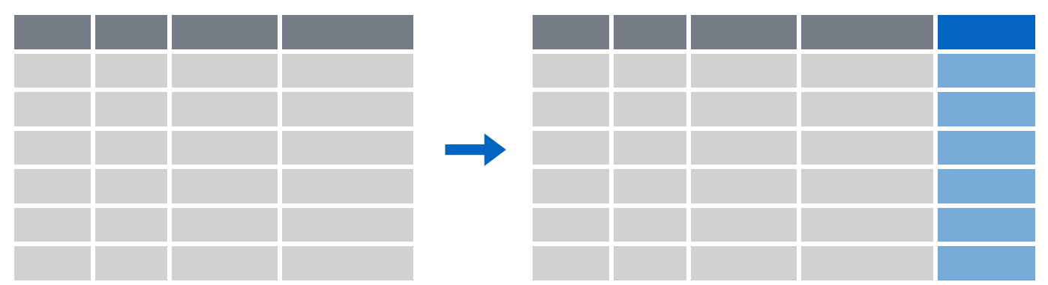
mutate()
Create new calculated columns
= Number of rows
↑ Number of Columns
Notes:
The goal of mutate() is very simple. You’ll feed it your original data frame and it’s going to kick out the same data frame with one or more new columns tacked onto the end based on calculations that you specify.

Slide 26
mutate()
Create new calculated columns
covid_testing %>%
mutate(new_column = calculation)
name for new column
single
equals
what to put in the new column
Notes:
The syntax is going to look familiar to the functions we saw earlier but with a small change. As before, the first argument is the original data frame, which gets piped into mutate. Then you specify the name of the new column you want to add, you type of an equals sign, and then you write a calculation. This calculation will be run on each row of your data frame and the result will populate each row of the new column.

Slide 27
mutate()
calculation can involve another column in the data frame
Create new calculated columns
covid_testing %>%
mutate(c_r_tat_mins = col_rec_tat * 60)
mrn | col_rec_tat | rec_ver_tat
5000876 | 29.5 | 11.5
5006017 | 3.6 | 5
5001412 | 1.4 | 5.2
5000533 | 2.3 | 5.8
mrn | col_rec_tat | rec_ver_tat | c_r_tat_mins
5000876 | 29.5 | 11.5 | 1770
5006017 | 3.6 | 5 | 216
5001412 | 1.4 | 5.2 | 84
5000533 | 2.3 | 5.8 | 138
Notes:
For instance, right now the TAT columns are coded in hourse. if we want to calculate the TAT in minutes we could use code such as this.
We take the covid_testing data set and pass it to the mutate function. In the mutate function we will
Make a name for our new column
Put an equals sign
Define the calculation whose result will populated the new column, in this case we can directl reference the col_rec_tat column and multiply by 60.

Slide 28
Your Turn #1
Open 03 – Transform.qmd and work through the first set of exercises.
Click “yes” when you are finished.

Slide 29
Grouping your data
Notes:
To answer this question we need to be able to group data.

Slide 30
group_by()
Notes:
Group_by is a challenging function to master, but extremely powerful. It is one of those tools that once you understand how to use, you cannot possibly go back to live without it.
Group_by allows us to take a data frame and break the observations up into several groups.
Then we can “look” at those groups separately.

Slide 31
group_by()
Grouping observations based on a specific variable’s values
covid_testing %>%
group_by(variable)
name of variable to group by
Notes:
Here is the code construct for grouping.
We pass a data set using pipes to the group_by() function.
Then we specify the variable that we want to define groups.

Slide 32
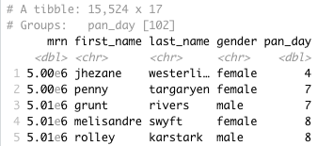
group_by()
Group observations by pan_day
covid_testing %>%
group_by(pan_day)
Notes:
Let’s look at a example of grouping by pan_day.
We can see that the resulting object has 15,524 rows that are broken up into 102 groups.
This means there are 102 distinct `pan_day`’s.
Some of these groups will have a single observation. Many of these groups will have more than one observation.

Slide 33
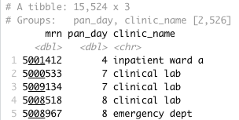
group_by()
Group observations by `pan_day` and `clinic_name`
covid_testing %>%
select(mrn, pan_day, clinic_name) %>%
group_by(pan_day, clinic_name)
Notes:
We can also group by more than one variable.
We can see that the resulting object has 15,524 rows that are broken up into 2,526 groups.
This means there are 2,526 distinct combinations of `pan_day` and `clinic_name`.
Some of these groups will have a single observation. Many of these groups will have more than one observation.
Also, not all theoretical combinations of `pan_day` and `clinic_name` exist; only 2,526 such combinations exist.

Slide 34
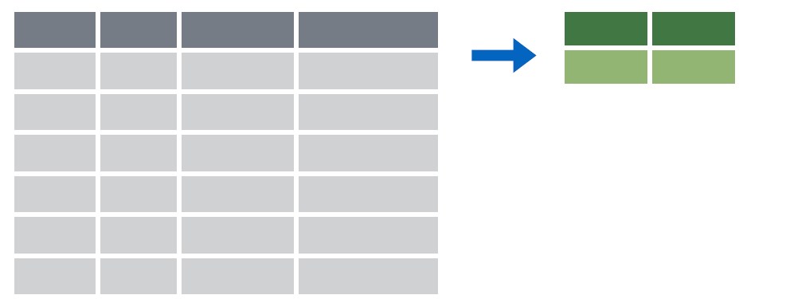
summarize()
Make summaries of your data
Notes:
Summarize allows us to take a variable (column) of data and apply a function (or functions) to all observations.
Using summarize we can return a single value, or summary.

Slide 35
summarize()
Make summaries of your data
covid_testing %>%
summarize(new_variable = calculation)
name for new variable
Value or function
Performs calculation across all rows of data frame
Notes:
To make summaries of our data we use the following code construct.
We pass a data set using pipes to the summarize function.
Within the summarize function we provide a variable name and set it to a calculation or value that we define.

Slide 36
summarize()
function that returns number of observations
Make summaries of your data
covid_testing %>%
select(mrn, pan_day) %>%
head(4) %>%
summarize(order_count = n())
mrn | pan_day
5001412 | 4
5000533 | 7
5009134 | 7
5008518 | 8
order_count
4
Notes:
Let’s look at a simple example using summarize() to count the number of orders in a data set.
Note, that to simplify the data frame, we first will select 2 variables and include the first 4 observations.
n() returns the number of observations or rows for a data frame.

Slide 37
summarize()
function that returns number of distinct values
Additional summaries = new columns
covid_testing %>%
select(mrn, pan_day) %>%
head(4) %>%
summarize(order_count = n(),
day_count = n_distinct(pan_day))
mrn | pan_day
5001412 | 4
5000533 | 7
5009134 | 7
5008518 | 8
order_count
4
day_count
3
Notes:
n_distinct() counts the number of distinct, or unique, observations. So, while there are 4 rows, there are only 3 distinct days

Slide 38
summarize()
Summarize supports calculations on summary stats
covid_testing %>%
summarize(order_count = n(),
day_count = n_distinct(pan_day),
orders_per_day = order_count/day_count)
mrn | pan_day
5001412 | 4
5000533 | 7
5009134 | 7
5008518 | 8
order_count
15524
day_count
102
orders_per_day
152
Notes:
n_distinct() counts the number of distinct, or unique, observations. So, while there are 4 rows, there are only 3 distinct days

Slide 39
group_by()
%>%
summarize()
Make summaries of your data by group
Notes:
Just like we can apply summarize() to a full data frame, we can apply summarize() to each group separately.
The combination of group_by() and summarize() is extremely powerful.

Slide 40
group_by() %>% summarize()
Make summaries of your data
covid_testing %>%
summarize(order_count = n())
mrn | pan_day
5001412 | 4
5000533 | 7
5009134 | 7
5008518 | 8
order_count
15524
Notes:
Using summarize() without group_by() we can count how many total rows there are.

Slide 41
group_by() %>% summarize()
Make summaries of your data
covid_testing %>%
group_by(pan_day) %>%
summarize(order_count = n())
mrn | pan_day
5001412 | 4
5000533 | 7
5009134 | 7
5008518 | 8
pan_day
4
7
8
9
order_count
1
2
3
9
Notes:
Adding group_by(), we count how many rows there are for each `pan_day`.
This is the data that underlies the figure we looked at in slide 6.

Slide 42
Your Turn #2
Within 03 – Transform.qmd work through the second exercise, starting from where you stopped after the last exercise.
Click “yes” when you are finished.

Slide 43

Recap
Extract columns with select()
Filter rows by logical criteria with filter()
Create new columns with mutate()
Notes:
To recap what we covered up to this point, …
(**) Analyzing data with with Excel, or similar spreadsheet software, can compromise data quality, and may ultimately lead to patient harm. This is because Excel does not record user interactions and it’s easy to make simple errors that can be very difficult to uncover later.
(**) Instead, you could use a reproducible workflow in which the entire analysis is automated with computer code, and we looked at how doing that can improve your confidence in the validity of an analysis.
(**) and finally, we defined “computational document” as documents that have executable code inside of them and we went over how computational documents are a key ingredient of reproducible workflows.

Slide 44
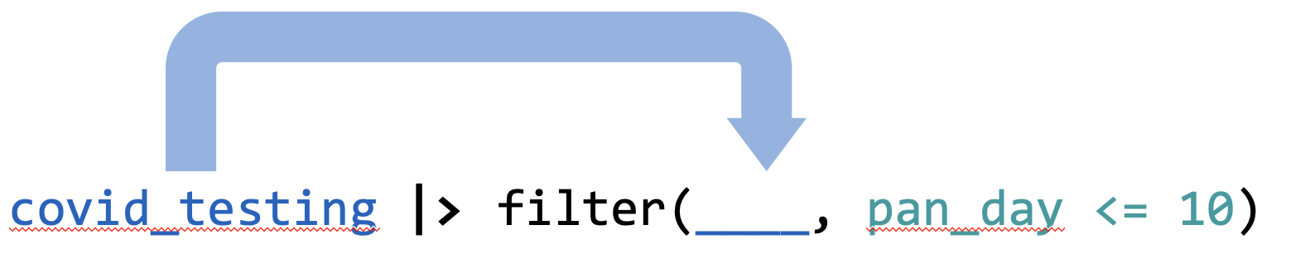
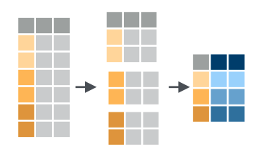
Recap
Use the pipe operator %>% to combine data transformation steps into a pipeline
Use group_by to create subgroups within your data set and summarize to calculate summary statistics for each group
data |>
group_by(...) |>
summarize(...)
Notes:
To recap what we covered up to this point, …
(**) Analyzing data with with Excel, or similar spreadsheet software, can compromise data quality, and may ultimately lead to patient harm. This is because Excel does not record user interactions and it’s easy to make simple errors that can be very difficult to uncover later.
(**) Instead, you could use a reproducible workflow in which the entire analysis is automated with computer code, and we looked at how doing that can improve your confidence in the validity of an analysis.
(**) and finally, we defined “computational document” as documents that have executable code inside of them and we went over how computational documents are a key ingredient of reproducible workflows.

Slide 45
What else?

Slide 46
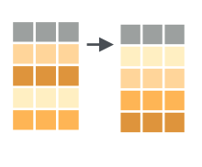
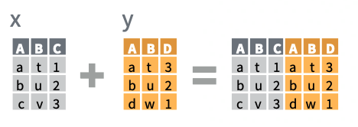
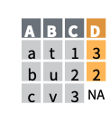
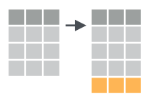
More dplyr functions
x |>
bind_cols(y)
arrange(data, ...)
x |>
left_join(y)
add_row(data, ...)

Slide 47
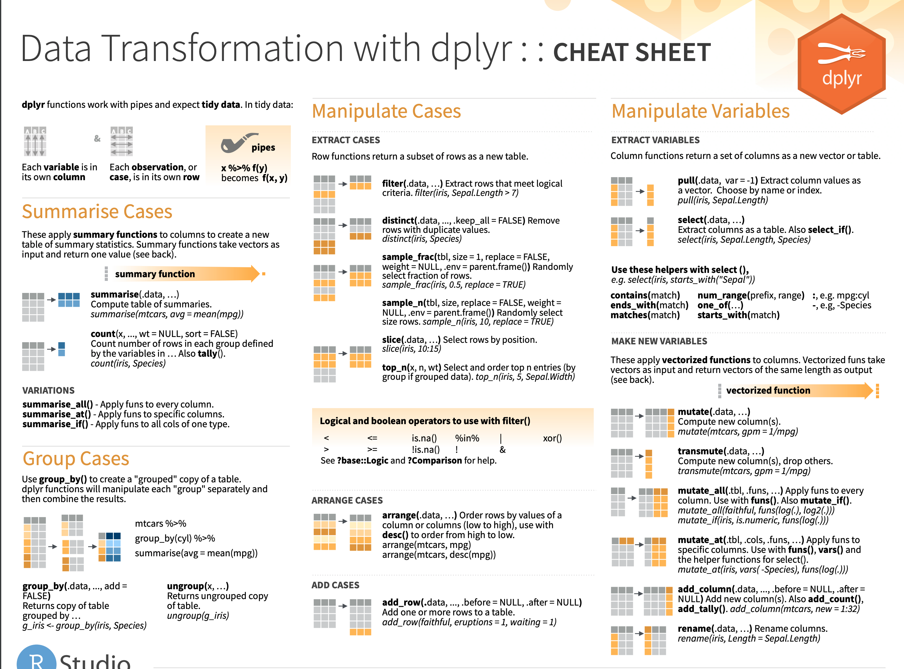
Notes:
Cheat sheets would go here

Slide 48
Notes:
Reference thhe universe of packages that assist in data processing

